Slide 1
CAS/WWRP Contributions to DRR
Dan Sandink, MA, MScPl
Manager, Resilient Communities & Research
Institute for Catastrophic Loss Reduction
October 14, 2013

Slide 2
Introduction/Context
Representing CAS for Paul Kovacs, member of the Societal and Economic Research and Applications Working Group (SERA WG) of the World Weather Research Programme (WWRP)
Presentation illustrates potential contributions from WWRP and that of SERA and its members’ partners/networks
More detail will be provided to DRR following the meeting and after further consultation with WWRP WGs

Slide 3

WWRP overview
One arm of the Commission for Atmospheric Sciences (CAS) (Global Atmosphere Watch is the other)
Mission: …advances society's ability to cope with high impact weather through research focussed on improving the accuracy, lead time and utilization of weather predictions.

Slide 4
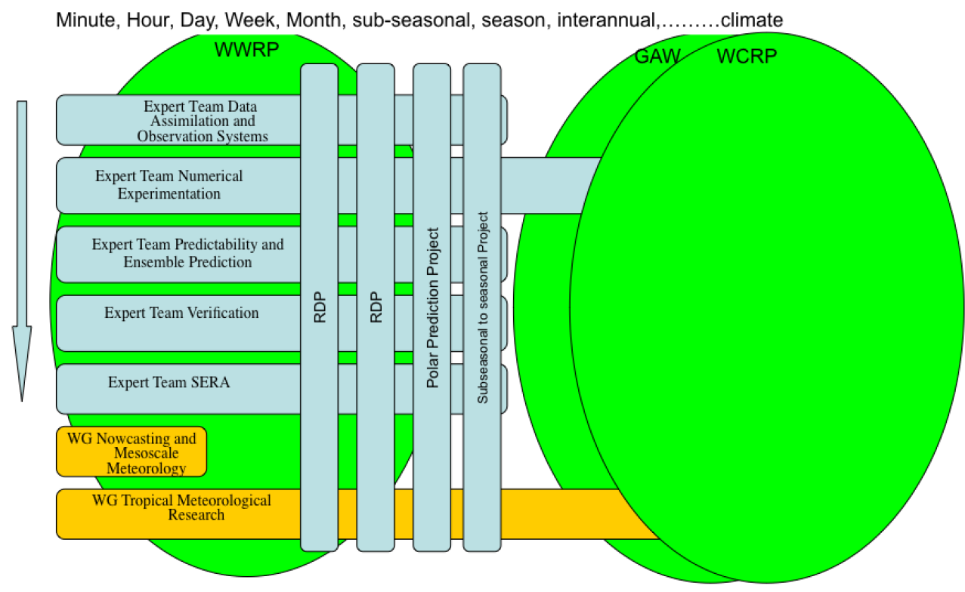
WWRP overview
Transitioning to this structure with the end of THORPEX:
Notes:
Acronyms: WWRP-World Weather Research Programme; WG-working group; RDP-Research Demonstration Project; GAW-Global Atmosphere Watch (the other main component of the CAS but not covered in this presentation); WCRP-World Climate Research Programme (another programme partly run through the WMO Research Department but co-sponsored with ICSU and others)
This is the structure that the WWRP is transitioning to…as the major Thorpex (The Observing system Research and Predictability Experiment), focussed on prediction in the days to 2-week period, ends in 2014.
The horizontal expert teams, transitioning from WGs, run across and provide input to existing and new projects, including high profile activities to improve prediction in polar regions, at the subseasonal to seasonal scales, and, not shown but coming, on High Impact Weather in the shorter ranges of prediction
Some ETs extend or are jointly shared with GAW and WCRP

Slide 5
Initiatives, tools, projects
THORPEX (The Observing system Research and Predictability Experiment), focussed on prediction in the days to 2-week period, ends in 2014
  Shifting work to specific projects:
    Polar prediction
    Sub-seasonal to seasonal forecasts
    High Impact Weather Research Demonstration Project (in development)
    Numerous regional research and development (RDPs) and forecast demonstration projects (FDPs)

Slide 6
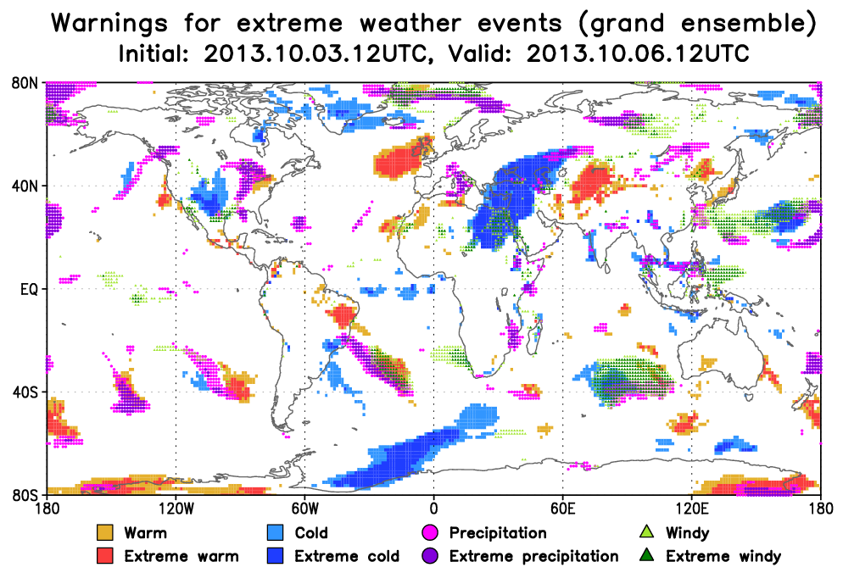
Two types of contributions
Contributions to DRR:
  Specific WWRP initiatives, tools, or projects
  Scientific, social scientific, and user expertise associated with the membership of various ETs and WGs
Notes:
ET – Expert Team; WG – Working Group

Slide 7
Specific WWRP initiatives
THORPEX Interactive Grand Global Ensemble (TIGGE) Database (R. Swinbank, M. Kyouda—WG co-chairs)
  Collection of ensemble predictions from 10 of the leading global forecast centres (2006-present)
  TIGGE data are made available after a 48-hour delay, to support research on probabilistic forecasting methods, predictability and dynamical processes
  Products derived from TIGGE data can inform hazard event occurrence, frequency, severity
  Provides a picture of what forecast information (and uncertainty) was available during particular events

Slide 8
TIGGE example product
Notes:
These are predictions from multiple runs of 4 weather models (ensemble of predictions) made at the initial date/time (October 3, 12 UTC time or 8am EDT) for the 24 hour period (precipitation accumulation or extreme temperature/wind speed) immediately prior to the valid date.
Extreme weather is identified by comparing the actual model forecast values with the model forecast climatology—where 50% or more ensemble members (individual model runs) exceed the 90th percentile of the model climatology then these regions are highlighted in colour (warm, cold , precipitation, windy). If 50% or more exceed the 95th percentile then they are deemed “extreme”.
While useful on its own, these categories and products would be more informative if combined with actual hazard impact data, including social and economic criteria.

Slide 9
TIGGE—more information
Database Portal http://tigge.ucar.edu/home/home.htm
Thorpex TIGGE Working Group Activities
http://www.wmo.int/pages/prog/arep/wwrp/new/thorpex_gifs_tigge_index.html
TIGGE “Museum” of Applications (M. Matsueda and T. Nakazawa)
http://tparc.mri-jma.go.jp/TIGGE/

Slide 10
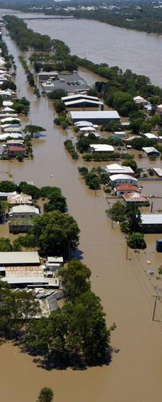
Sub-seasonal to seasonal prediction initiative
WWRP/THORPX—WCRP joint research project
Particularly important for management decisions in agriculture and food security, water, DRR and health
  Up to 60 day forecasts
  Integrated with TIGGE
Special emphasis on high-impact weather events – e.g., heat waves, cold spells, flooding, tropical cyclones
Testing and verification of forecasts and quantification of uncertainty
Working with SERA on demonstration projects based on recent extreme events and impacts
2011 Australian Floods – Source: Associated Press, 2011
http://www.wmo.int/pages/prog/arep/wwrp/new/S2S_project_main_page.html

Slide 11
Scientific, social scientific, and user expertise
Example from the Societal and Economic Research and Applications (SERA) Working Group/Expert Team
  Other WWRP WGs—for example on Verification—have relevant expertise as well
MEMBER (not all are listed) | HAZARD-RELEVANT EXPERTISE/APPLICATION AREA
Kwabena Anaman (University of Ghana) Jeff Lazo (NCAR) | Sensitivity of economy to weather, economic impact of weather-related events and hazards; social and economic value of weather information
Linda Anderson-Berry (Australian Bureau of Meteorology) | Community-level impacts and responses to hazards and disaster events
David Johnston (Massey University and GNS Science) | Human responses to volcano, tsunami and weather warnings; crisis decision-making; and role of public education/participation in building community resilience and recovery
Brian Mills (Environment Canada) | National and regional lightning and weather-related transportation collision risk analysis; evaluation of the impact of weather-related information on decision-making and behaviour
Joanne Robbins (UK Met Office) | Development and integration of risk and impact prediction models into weather forecasting
Angelika Wirtz (Munich Re, former member) | International disaster loss and impact databases and trend analysis
Paul Kovacs (Institute for Catastrophic Loss Reduction) | Estimation of insured and total losses associated with disaster and hazard events; use of insurance and financial instruments to reduce or mitigate risk
Source: B. Mills, writ. Comm.
Notes:
This table is meant to be illustrative and indicates some of the expertise within one WWRP working group that is relevant to the DRR initiative.
Experts in other WWRP working groups, such as the one concerning ‘verification’, would also be relevant—lessons from how one verifies (expected relative to observed) a weather forecast vs. hazard or disaster event occurrence/impact level would be interesting topics for guidelines.
Transition from Paul’s entry to ICLR and rest of talk.

Slide 12
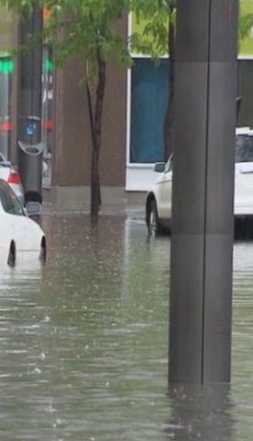
Partner contribution – disaster data, codes and vulnerability reduction
Water damage exceeded fire damage for insurance industry over past 10 years
IBC, 2012: ~$1.7 billion insured water damage per year in Canada—substantial uninsured damage
Many “small” events – under the radar of reinsurance industry (mini-cats), costs split between dozens of primary insurers

Slide 13
July 8, 2013
Western part of the highest population centre in Canada
Peak intensity of 240 mm/hr for 10 min. in south Mississauga
>$850 million insured damages
A problem across Canada, North America
Brampton
Mississauga
Toronto
Lake Ontario

Slide 14
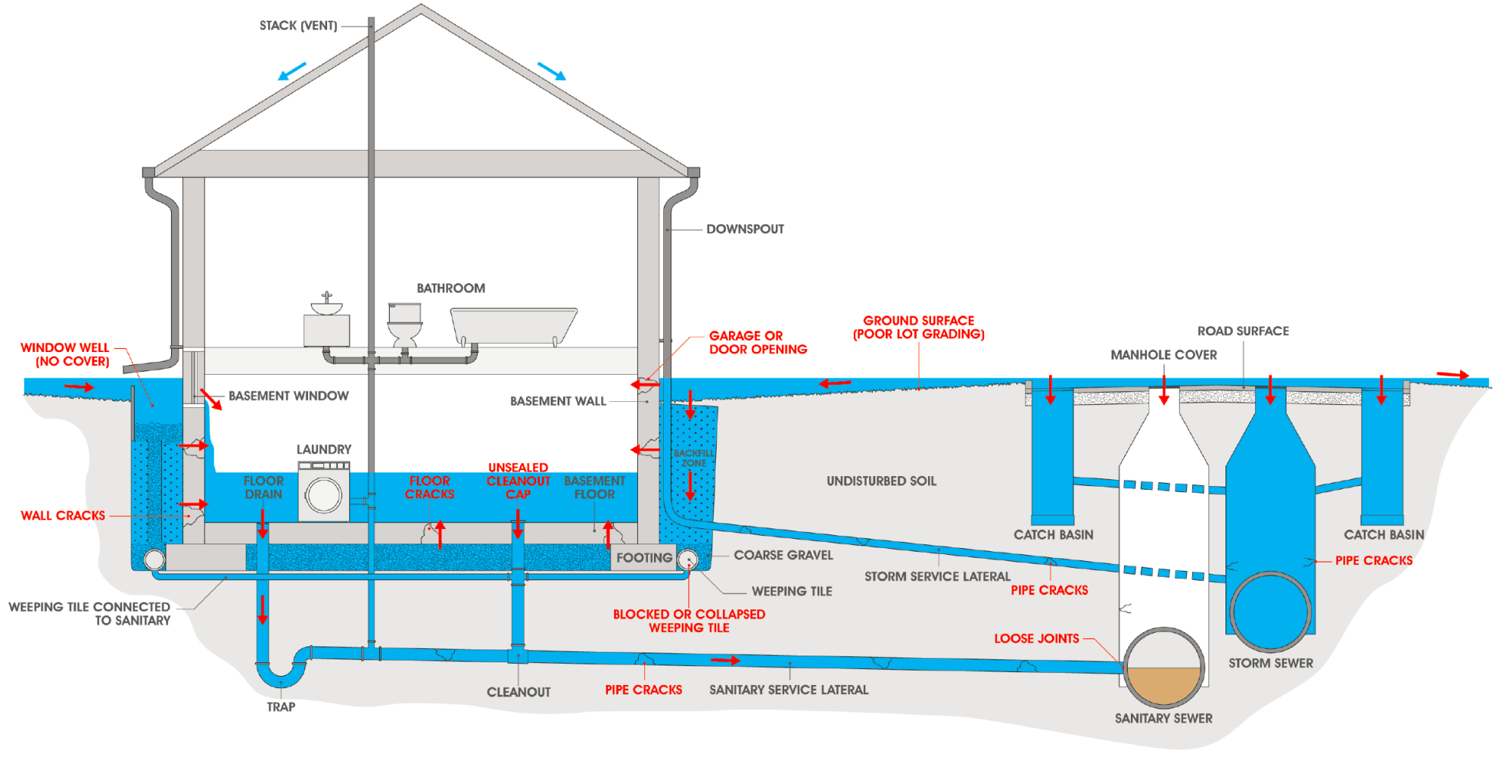
Overland flooding

Slide 15
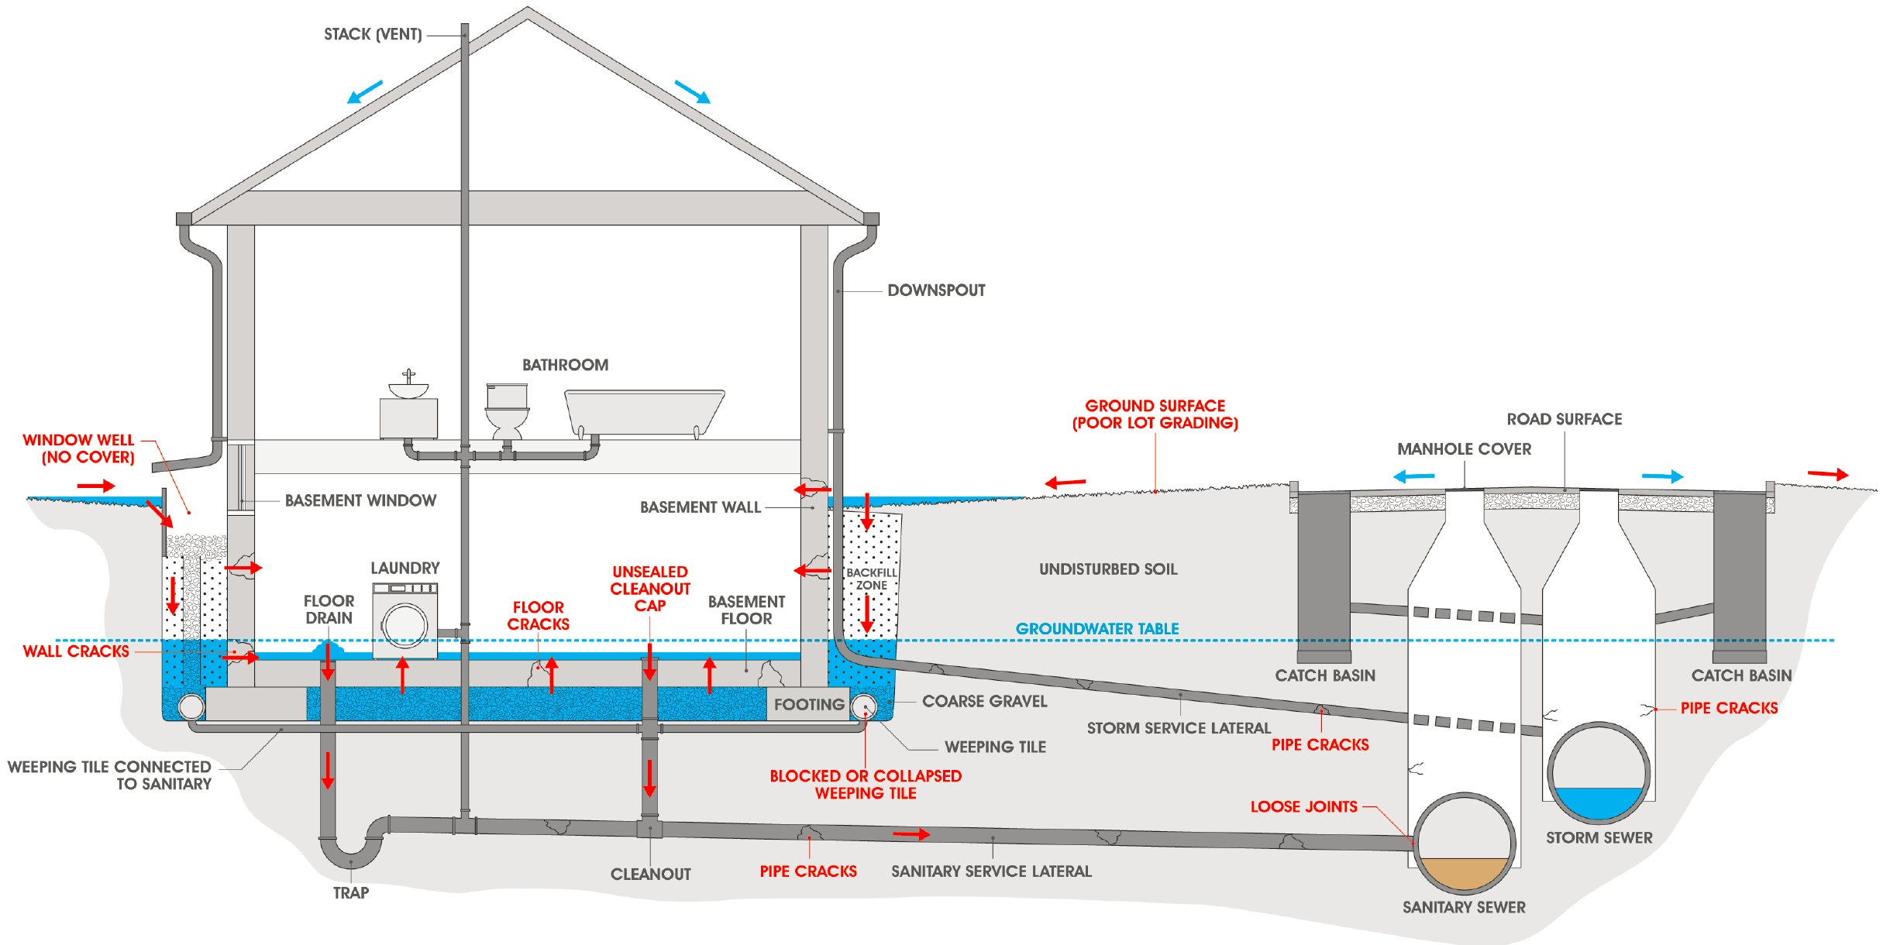
Infiltration flooding

Slide 16
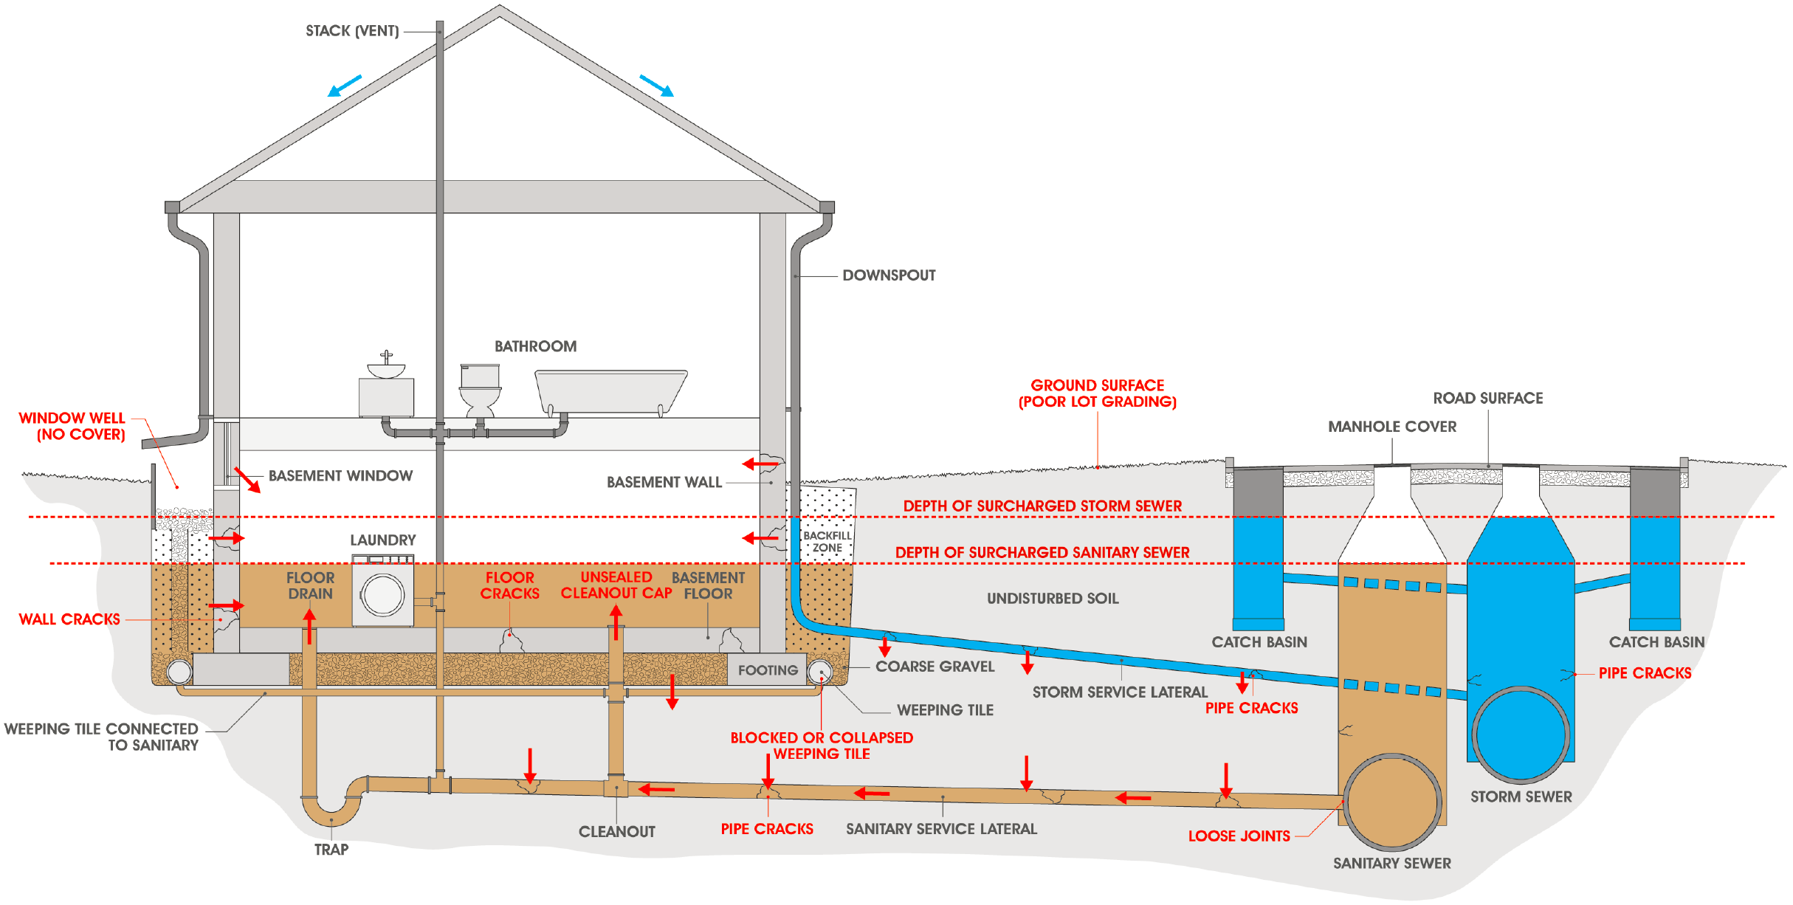
Infrastructure-related flooding

Slide 17
Urban flood risk reduction for non-engineered structures
Each type of flooding requires specific risk reduction measures
  Overland flood – overland flow routes, lot grading, height of building openings above-grade
  Infiltration flood – waterproofing membranes, lot grading, foundation drainage, sealing of cracks
  Infrastructure flood – removal of excess water from municipal systems, check valves in sewer connections
What was the mechanism of damage?
  Hazard definitions frequently used in disaster databases are not specific enough (e.g., “storm,” “flood,” “thunderstorm,” “hurricane,” etc.)

Slide 18
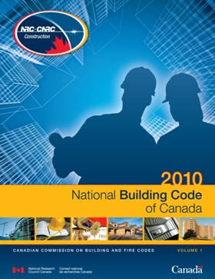
Building/Plumbing Codes in Canada
National level: Model codes
Provincial level: Adopt model codes, slight modification
Local/municipal level: Provincial code interpretation and implementation

Slide 19
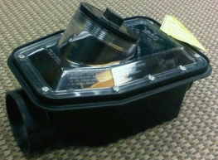
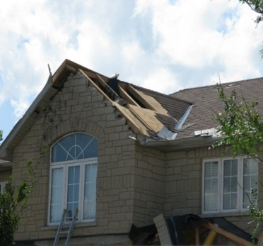
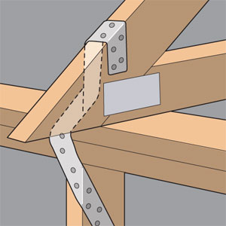
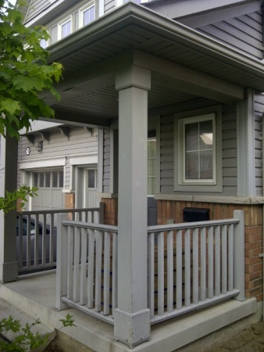
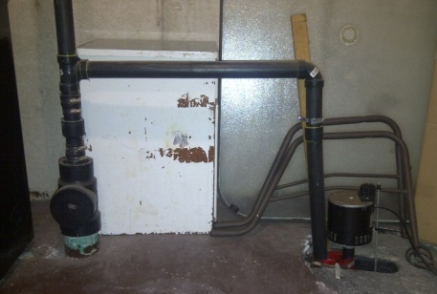
Specific code submissions for specific building failures
2012 NBC/NPC submissions
Clarify sewer backflow protection requirement
Align wall and roof sheathing fastening requirements
Bracing to resist lateral wind loads
Clarify connection of foundation drainage to sanitary/storm
Clarification of requirements for anchoring columns and posts
Notes:
Clarify sewer backflow protection requirement, remove reference to gate valves, floor drain screw caps (NPC 2.4.6.4.)
Align wall and roof sheathing fastening (NBC 9.23.3.5)
Bracing to resist lateral wind loads (NBC 9.23.3.4)
Clarify connection of foundation drainage to sanitary/storm (NBC 9.14.5.1)
Anchoring columns and posts (9.23.6.2.)

Slide 20

Policy-holder level claims data
Entered into databases using Kind of Loss Codes
  Fire – combined structural, wildland
    Buildings 10
    Contents 11
  Windstorm/hail – combined reporting
    Buildings 20
    Contents 21
    Special 29
  Water damage – combined reporting
    Buildings 30
    Contents 31
    Special (including flood, sewer backup, etc.) 39
G. Kopp, UWO
80% of insured losses can result from water penetration during wind storms – what was the mechanism of damage?

Slide 21
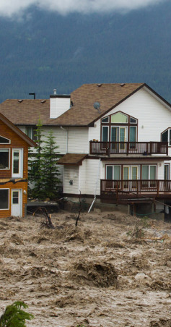
Other data issues in Canada
Lack of overland flood insurance for homes in Canada – no data collected by insurance industry
Government relief in place of insurance, however these programs do not provide full coverage for losses
Proprietary (insurance industry) data
Image: Global News, 2013

Slide 22
Addressing the discussion questions…
1: Forecasting projects, weather prediction
2: Plans to develop guidelines, manuals, standards: N/A
3: Hazard definitions: N/A
4: Existing guidelines, manuals and standards: N/A
5: Identifying needs of new users to guide development of guidelines, manuals and standards: N/A
6: Intra- and inter-commission mechanisms for development of guidelines, manuals and standards: N/A
7: Experts with hands-on experience in disaster risk assessment: Yes

Slide 23
Conclusion
Several WWRP projects, initiatives would be of value to DRR – many programs that are joint initiatives with other TCs
SERA would add social science, economic perspective
Further information on role of WWRP/SERA in DRR is forthcoming
Thank you!

